Slide 1

Team Name : AI Visionaries
Team Leader Name : Prathmesh Gattani
Problem Statement : AI for Learning & Developer Productivity

Slide 2

Brief about the Idea:
AI Project Brain
An AI-powered Persistent Organizational Memory System that continuously learns from project updates and enables intelligent contextual knowledge retrieval, onboarding, and decision tracking.
Problem:
Knowledge scattered across documents, code, emails
Repetitive knowledge transfer (KT)
Onboarding takes weeks
Dependency on senior developers
Solution:
AI system that:
Stores knowledge in compact structured form
Enables contextual Q&A
Generates onboarding roadmap
Tracks project evolution over time

Slide 3
How different is it from any of the other existing ideas?
❌ Existing Tools:
Google Drive → Just storage
Confluence → Manual documentation
Chatbots → No project-specific memory
✅ Our Differentiation:
Uses RAG (Retrieval Augmented Generation)
Builds semantic memory using vector embeddings
Context-aware answering
AI-powered onboarding mode
Timeline intelligence tracking

Slide 4
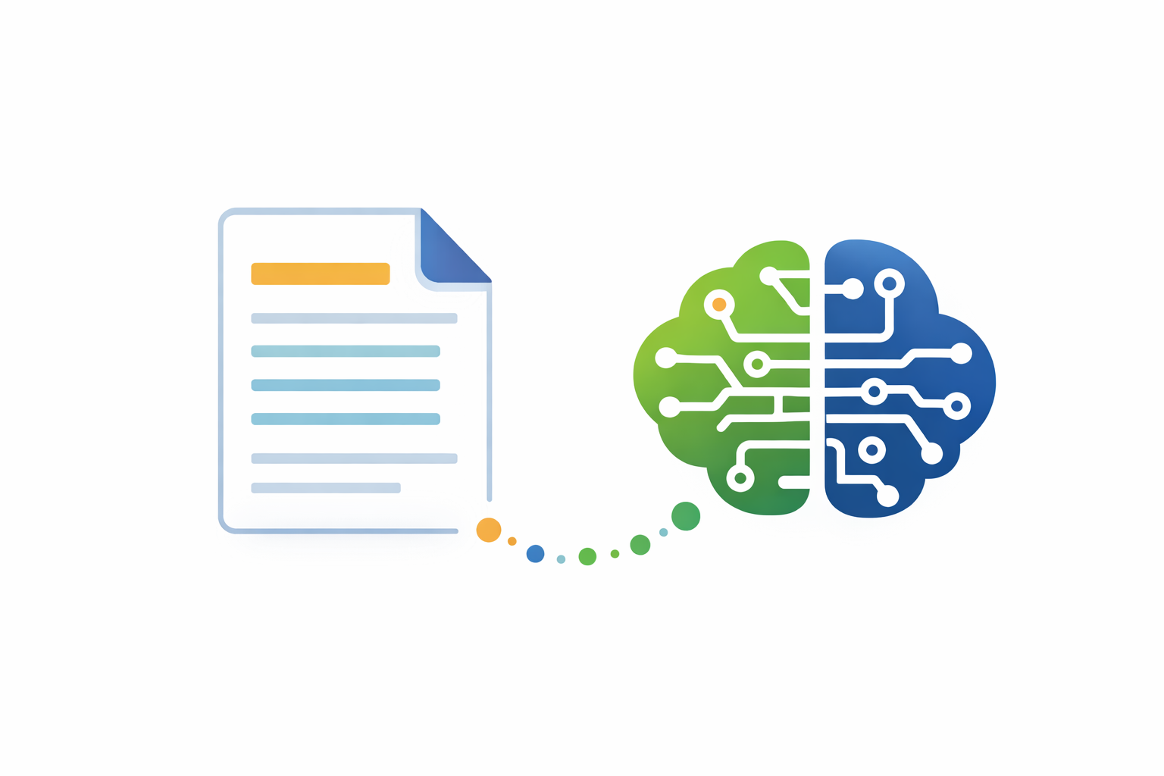
How It Solves the Problem ?
Before:
2–3 weeks onboarding
Multiple KT meetings
Knowledge loss when employees leave
After AI Project Brain:
Onboarding reduced to hours
Instant contextual answers
Structured decision history
Reduced dependency on individuals

Slide 5
USP of the Proposed Solution.
Features Offered
Persistent AI Memory
Contextual Project Understanding
AI Onboarding Assistant
Timeline Intelligence
Knowledge Graph Visualization
Scalable Enterprise Architecture
Core Features
Intelligent Knowledge Compression
Conversational Project Q&A
Smart Onboarding Mode
Timeline-Based Change Tracking
Knowledge Graph Visualization
Role-Based Information Views
Risk Insight Mode (Bug-prone area detection)

Slide 6
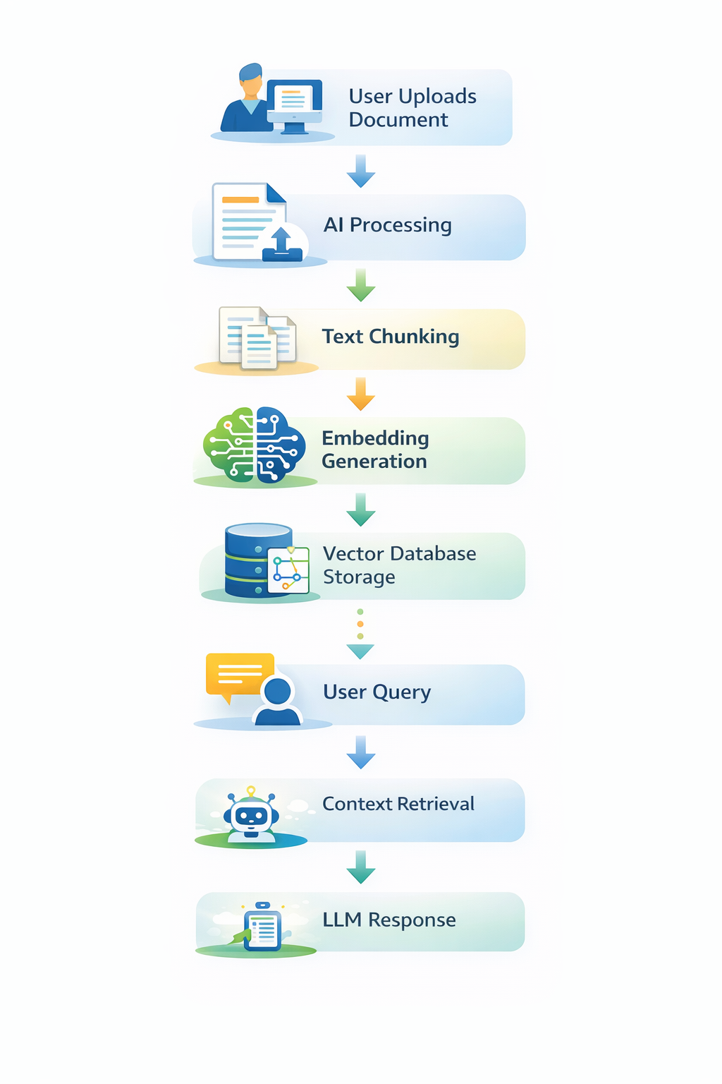
Process Flow Diagram
User Uploads Document
⬇
AI Processing
⬇
Text Chunking
⬇
Embedding Generation
⬇
Vector Database Storage
⬇
User Query
⬇
Context Retrieval
⬇
LLM Response

Slide 7
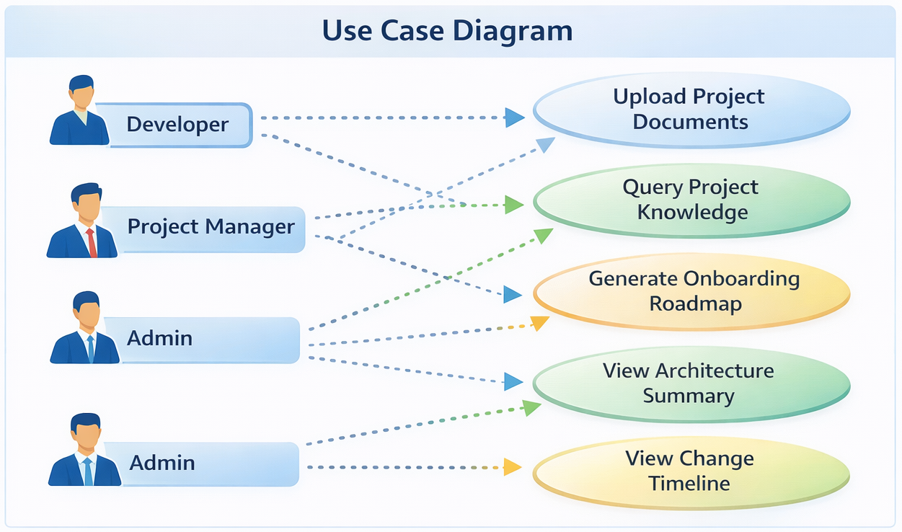
Use Case Diagram:
Actors:
Developer
Project ManagerAdmin
Use Cases:
Upload project documents
Query project knowledge
Generate onboarding roadmap
View architecture summary
View change timeline

Slide 8
Wireframe Idea (Mock Layout)
Screen 1:
Project Selection Dashboard
Screen 2:
Chat Interface
Screen 3:
Onboarding Mode
Screen 4:
Knowledge Graph View

Slide 9
Technologies to Be Used
Frontend:
Blazor
Bootstrap / Angular
Chart.js / Graph visualization
Backend:
ASP.NET Core
REST API
AI Layer:
Python Flask
LLM API
FAISS Vector Database
RAG Architecture
Deployment:
AWS EC2
AWS S3

Slide 10
Future Scope :
Impact :
Auto codebase understanding
Enterprise SaaS model
Healthcare knowledge system
Multi-language support (Bharat-focused)
Voice-enabled onboarding assistant
Integration with GitHub repositories
Reduces onboarding time by 70%
Increases productivity
Prevents knowledge loss
Scalable for enterprises
Can evolve into SaaS startup

Slide 11


